Slide 1
USB Device Control & Monitoring Framework
Aneesha Jimmis | Cybersecurity Internship Project

Slide 2
Project Objectives
Detect USB devices in real-time on connect and disconnect events
Extract Vendor ID, Product ID, and Serial Number for device fingerprinting
Verify devices against an allowlist — authorize or flag unknown devices
Monitor file creation, modification, and deletion in USB storage directories
Generate SHA256 hashes for all monitored files to ensure integrity
Produce timestamped audit logs and generate TXT security reports

Slide 3
Technologies Used
Python 3
Core language
Main scripting language for all modules
Pyudev
USB Monitoring
Real-time USB event detection via netlink
Watchdog
File Monitoring
Filesystem event handler for USB directory
Hashlib
Integrity
SHA256 hash generation for file auditing
Logging
Audit Logging
Timestamped event logging to usb_audit.log
Kali Linux
Platform
Running inside VirtualBox on macOS host

Slide 4
System Architecture
AUTHORIZED
Allow + Log
USB Device Connected
USB Detection
(pyudev)
Device
Fingerprinting
Allowlist
Verification
UNAUTHORIZED
Block + log
Vendor: 05ac = Apple Inc.
Audit Logging
(usb_audit.log)
File Monitoring
(watchdog)
SHA256 Hashing
(hashlib)
Security Report (report.txt)

Slide 5
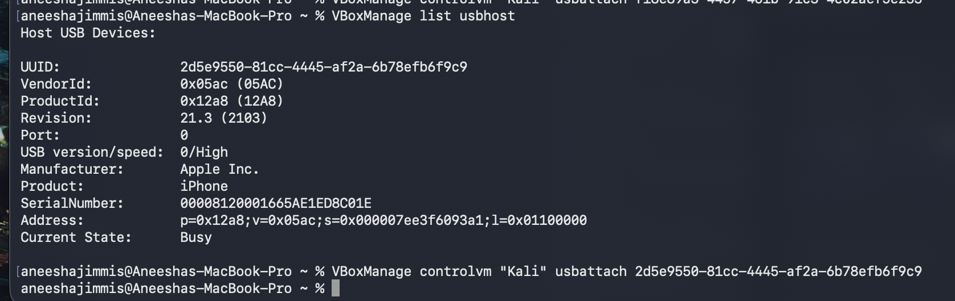
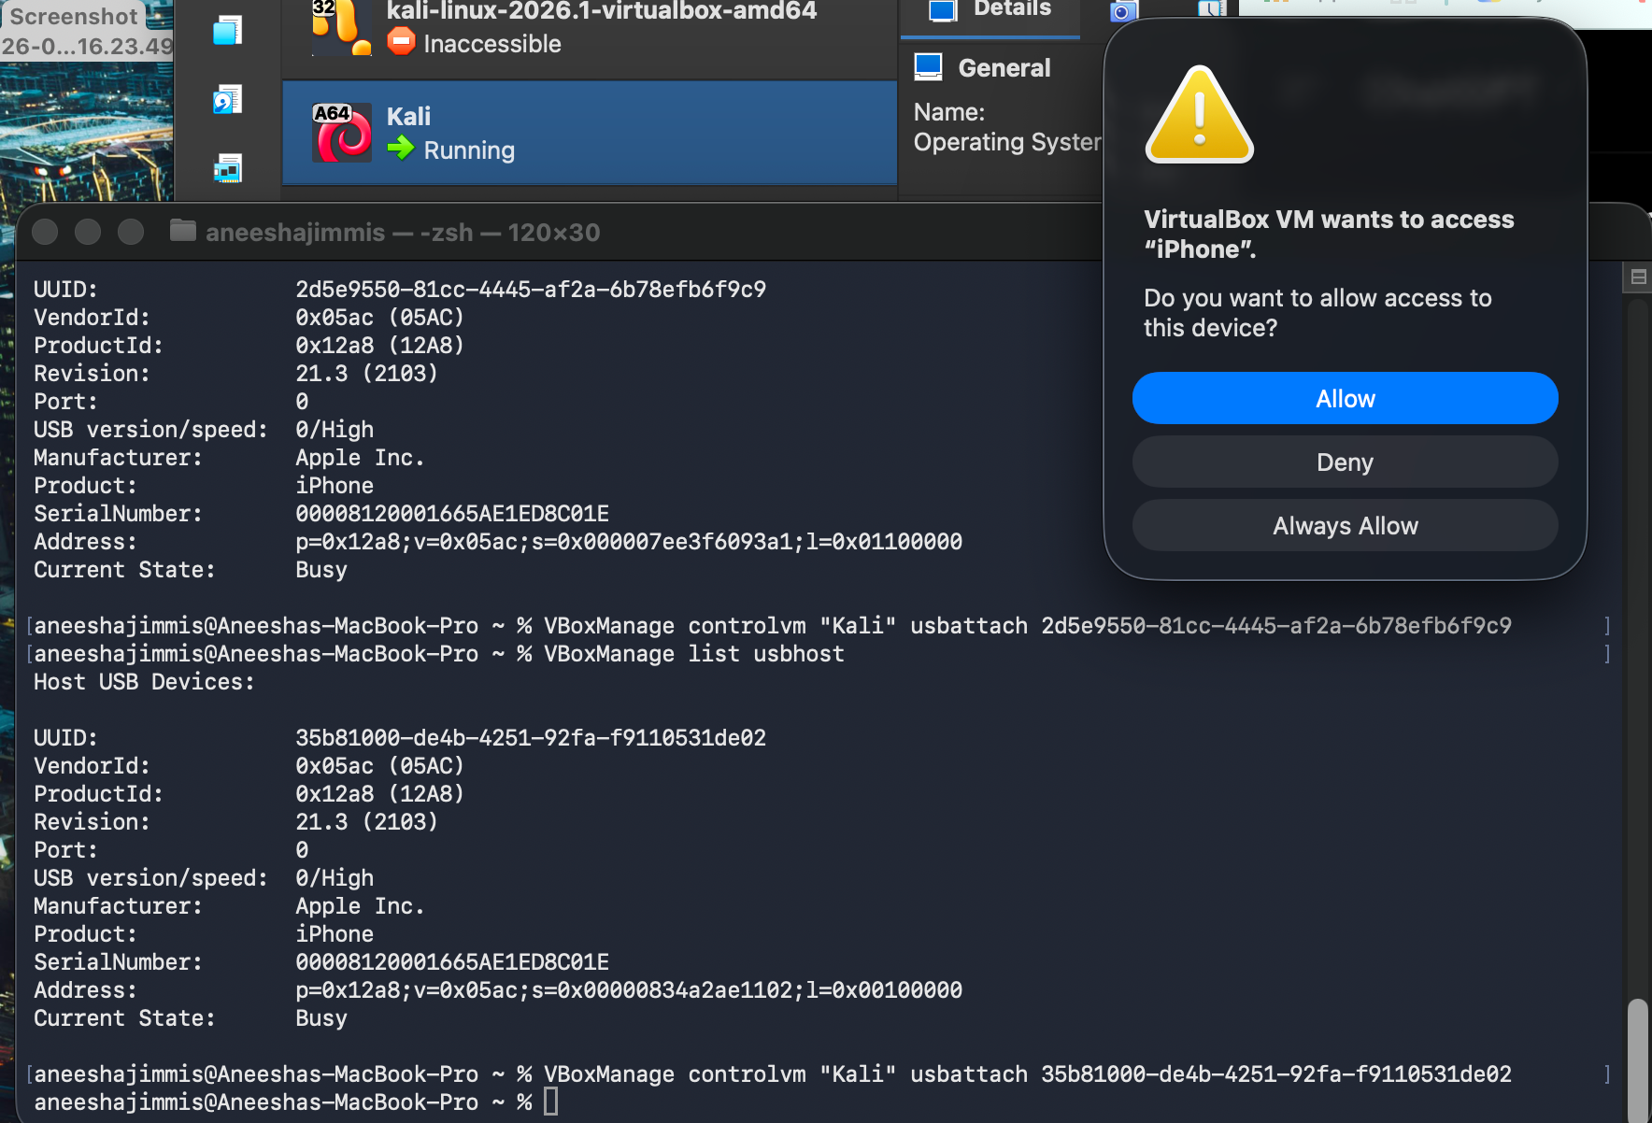
USB Passthrough Configuration (macOS → Kali Linux VM)
Connected iPhone to macOS host machine.
Identified the USB device using:
VBoxManage list usbhost
Retrieved the device UUID, Vendor ID, Product ID, and Serial Number.
Attached the iPhone to the running Kali VM using:
VBoxManage controlvm "Kali" usbattach <UUID>
Approved the VirtualBox permission request on macOS.
Verified successful detection inside Kali Linux.

Slide 6

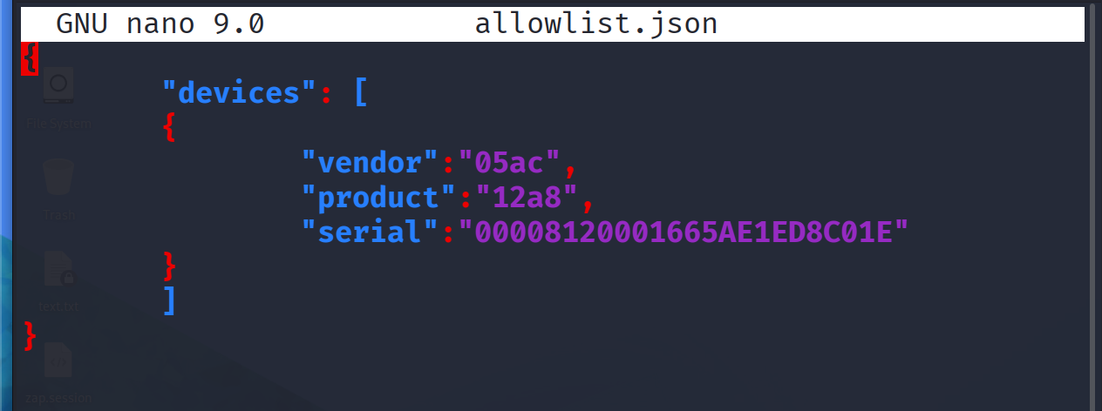
System Configuration and Project Files

Slide 7
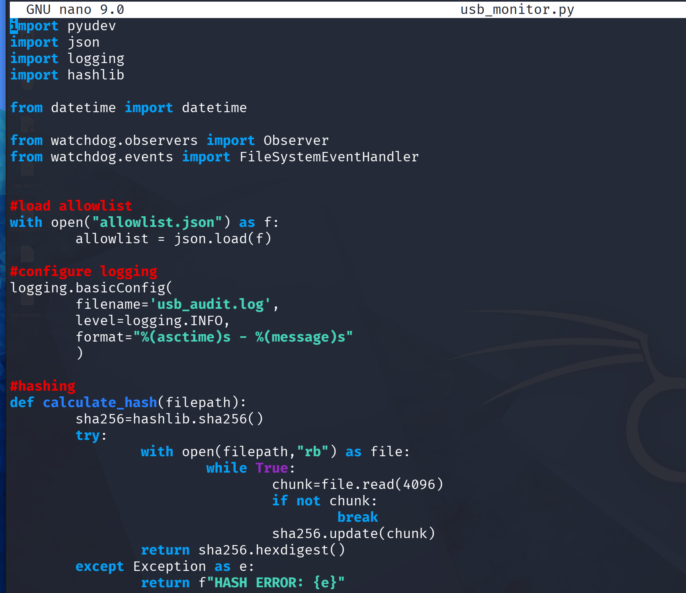

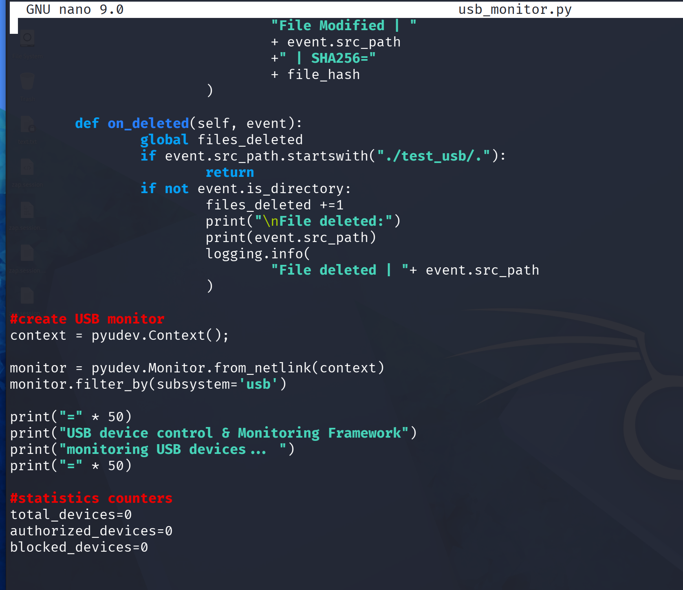
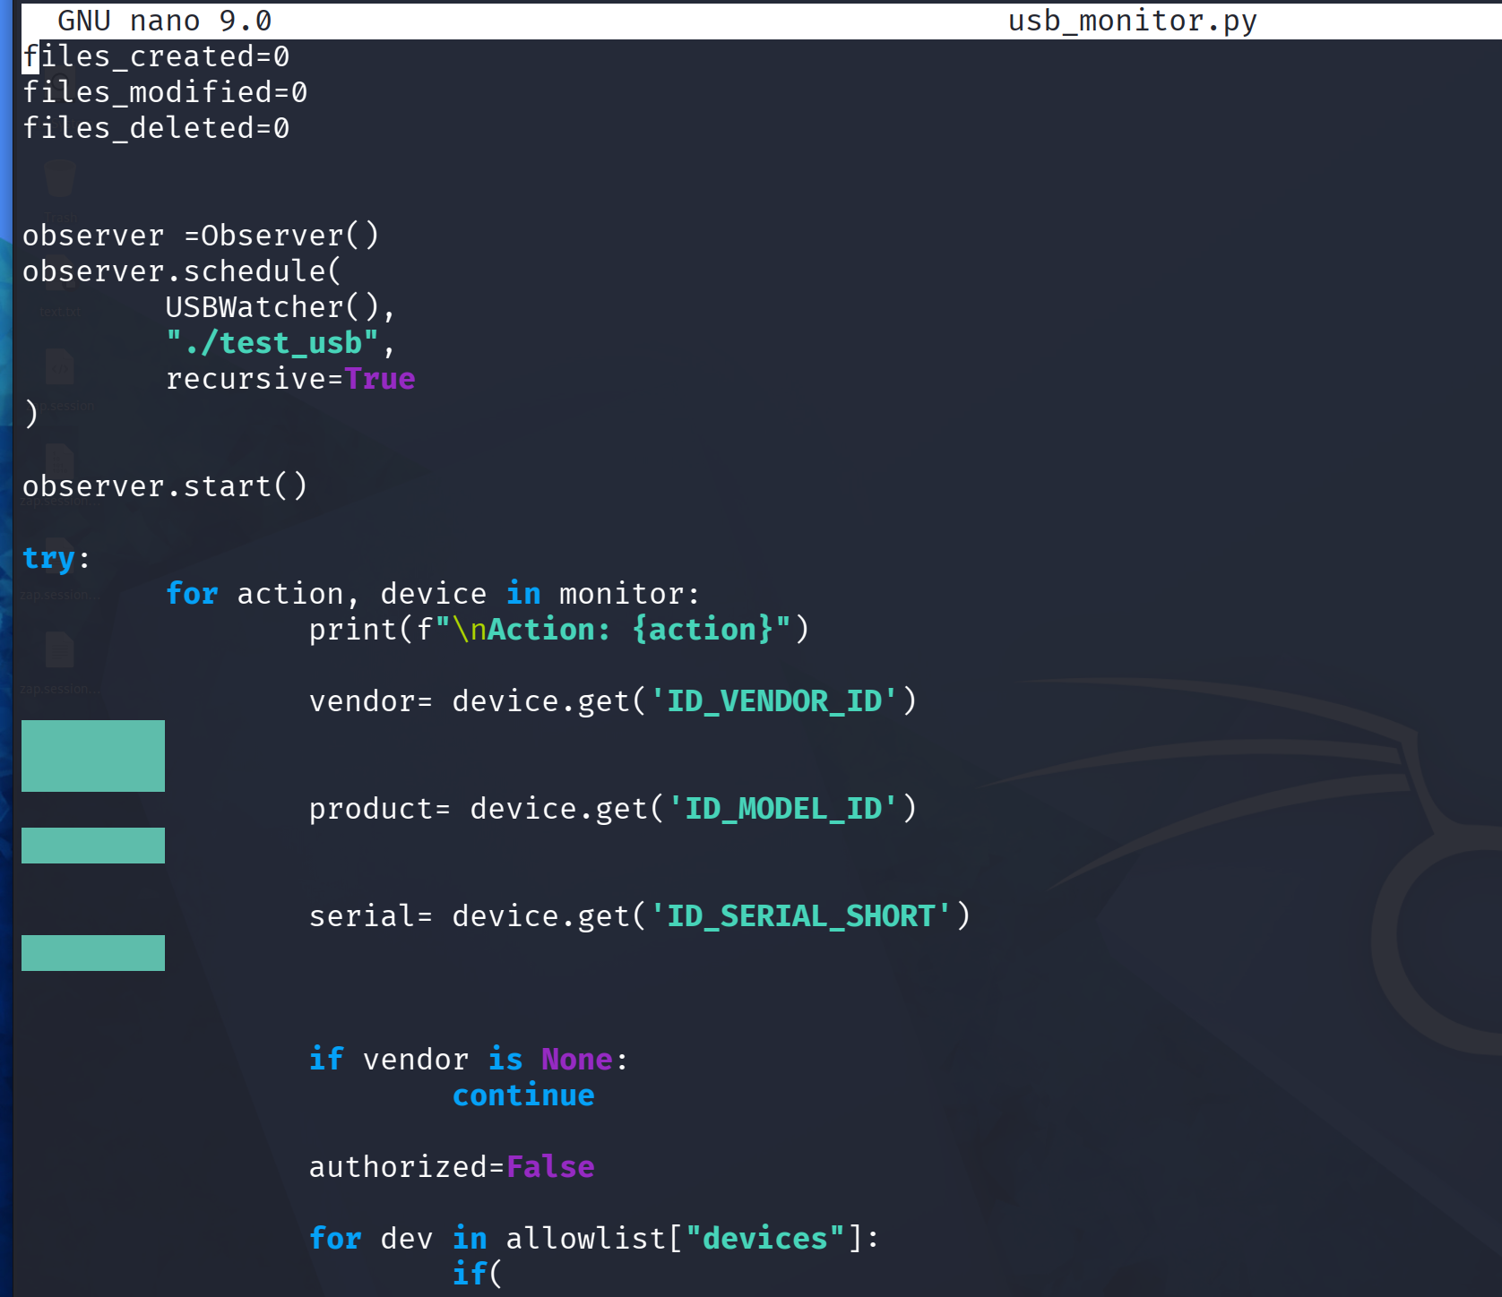
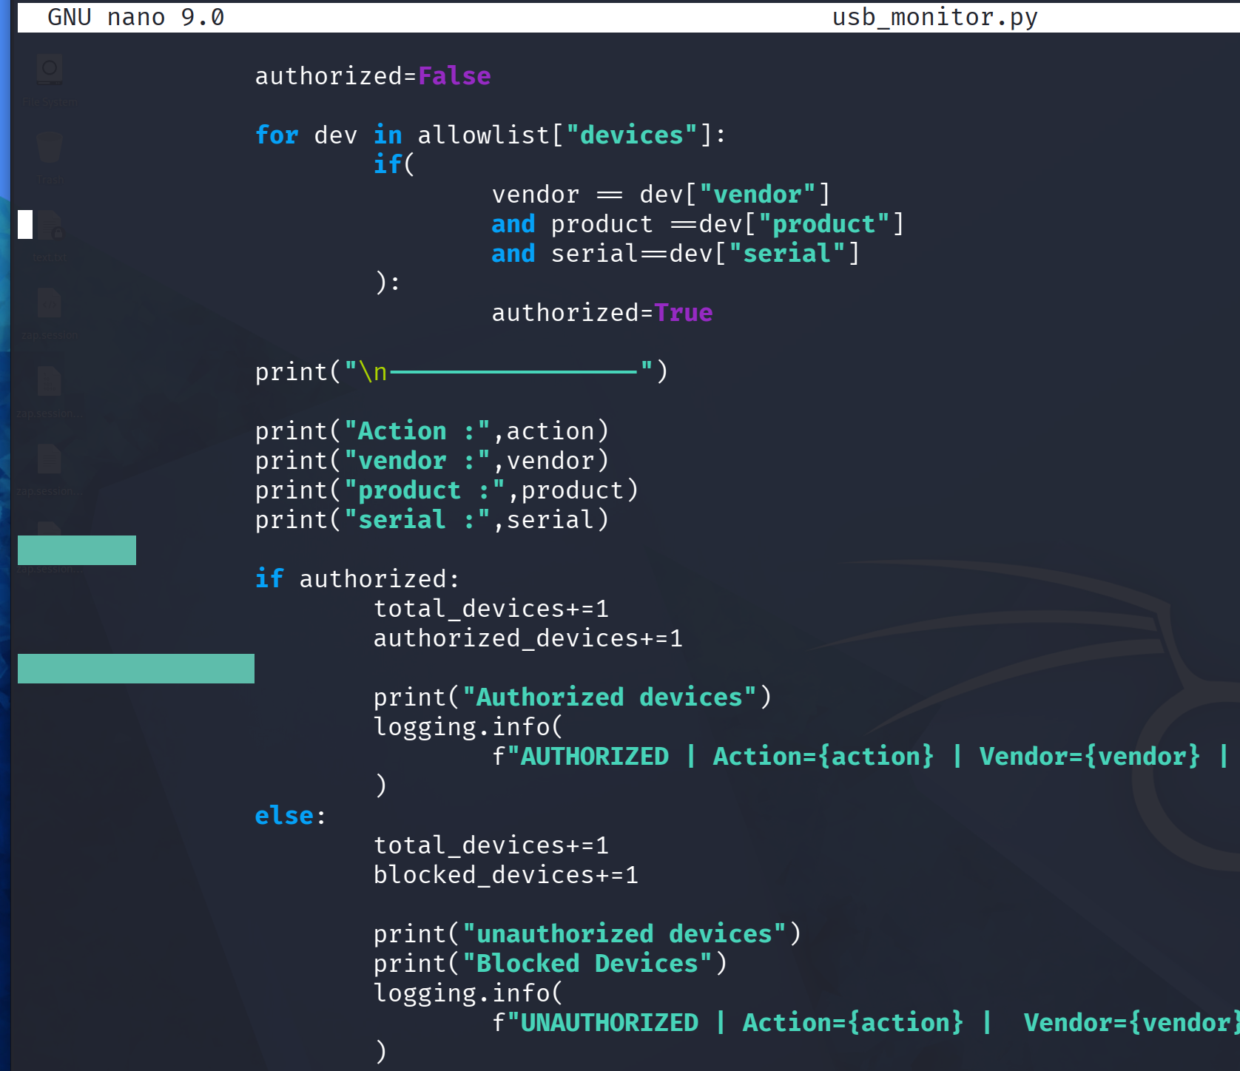
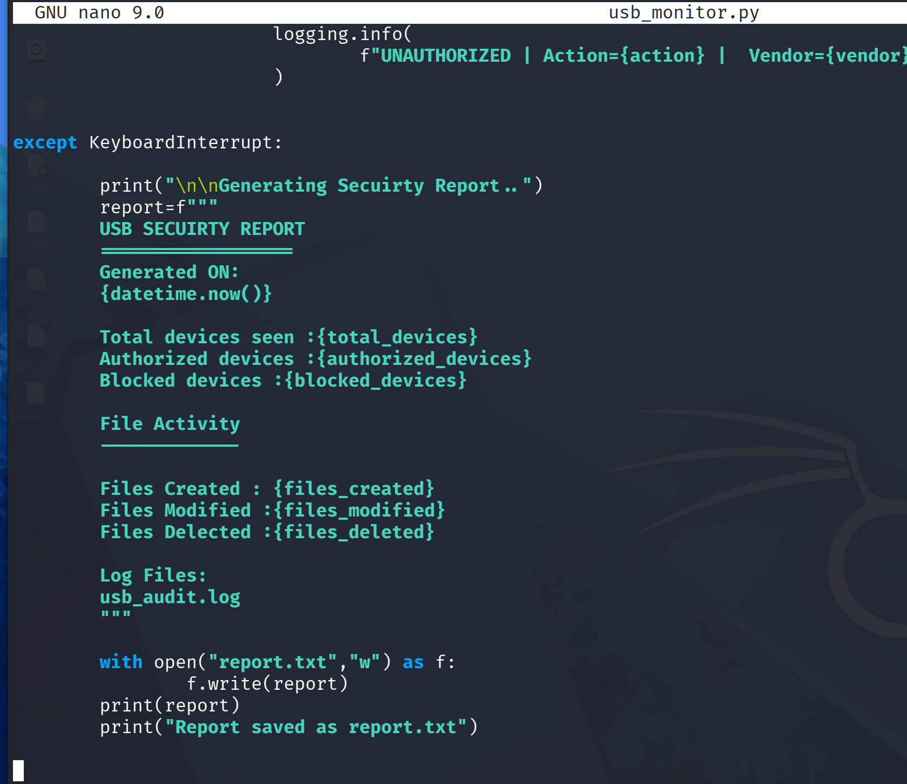
System Configuration and Project Files

Slide 8
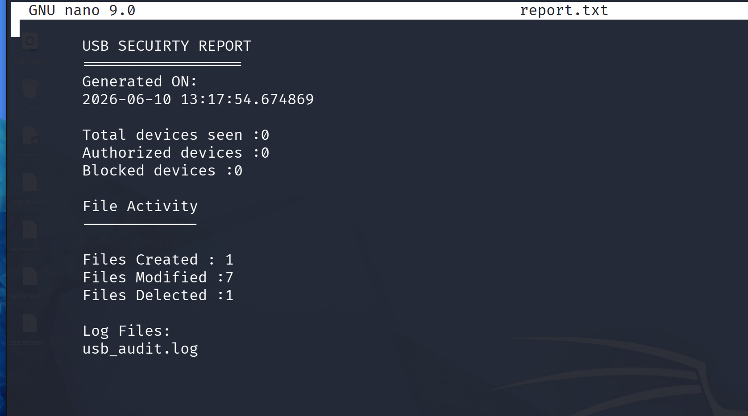
System Configuration and Project Files

Slide 9
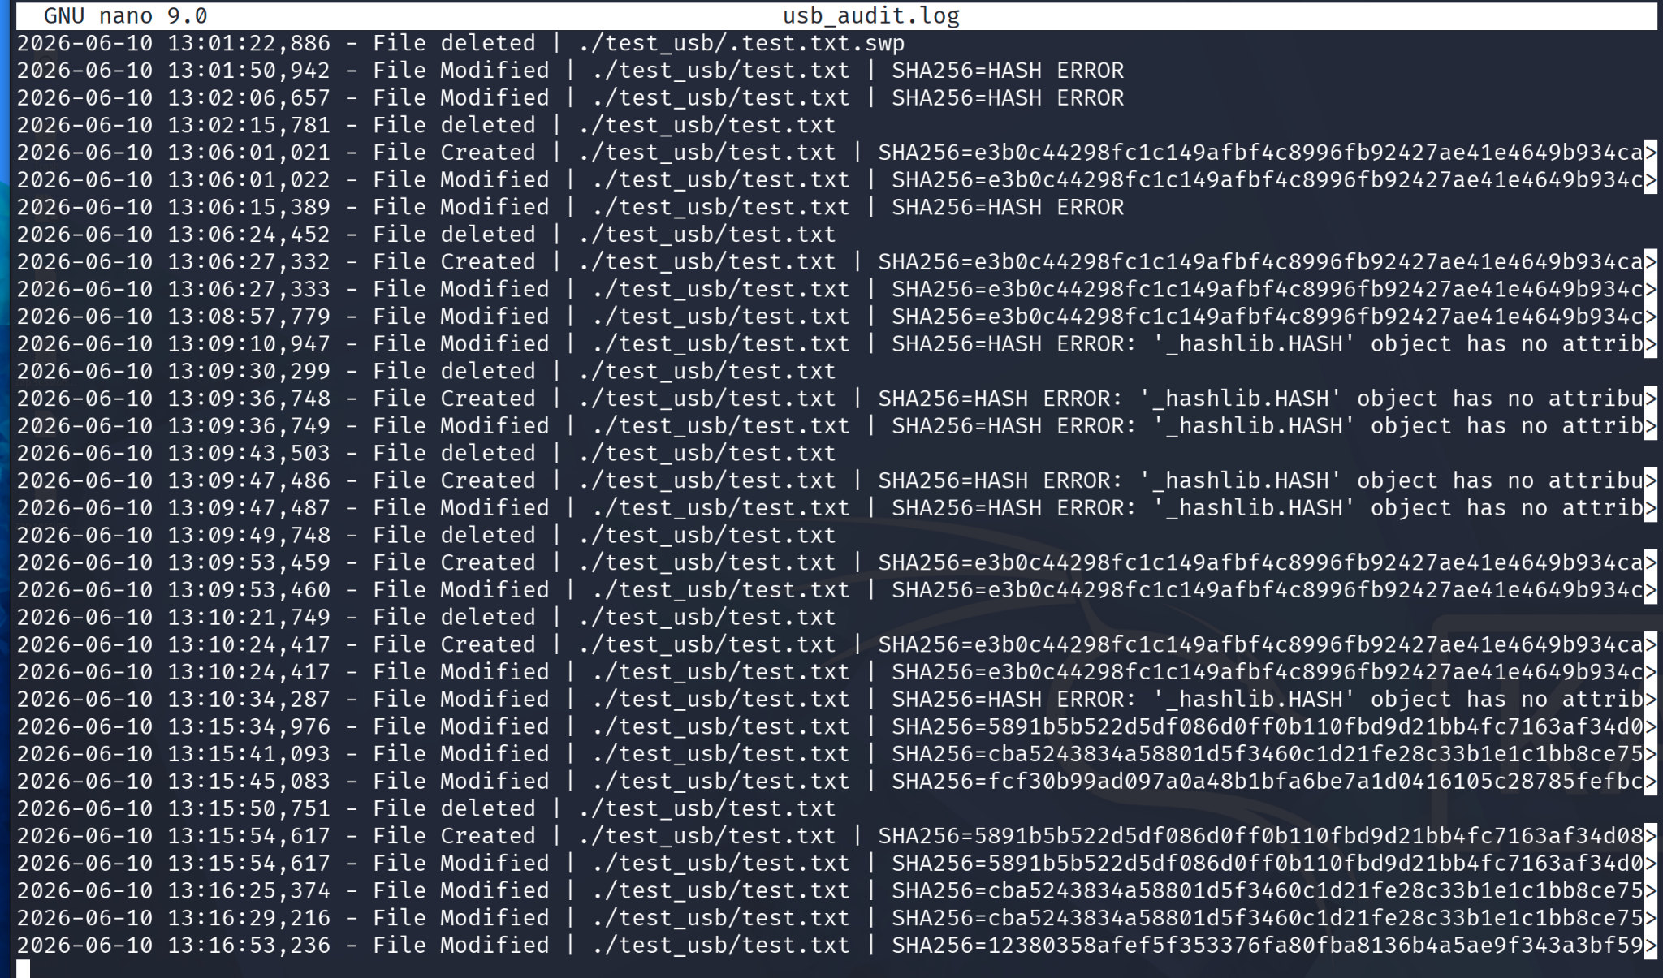
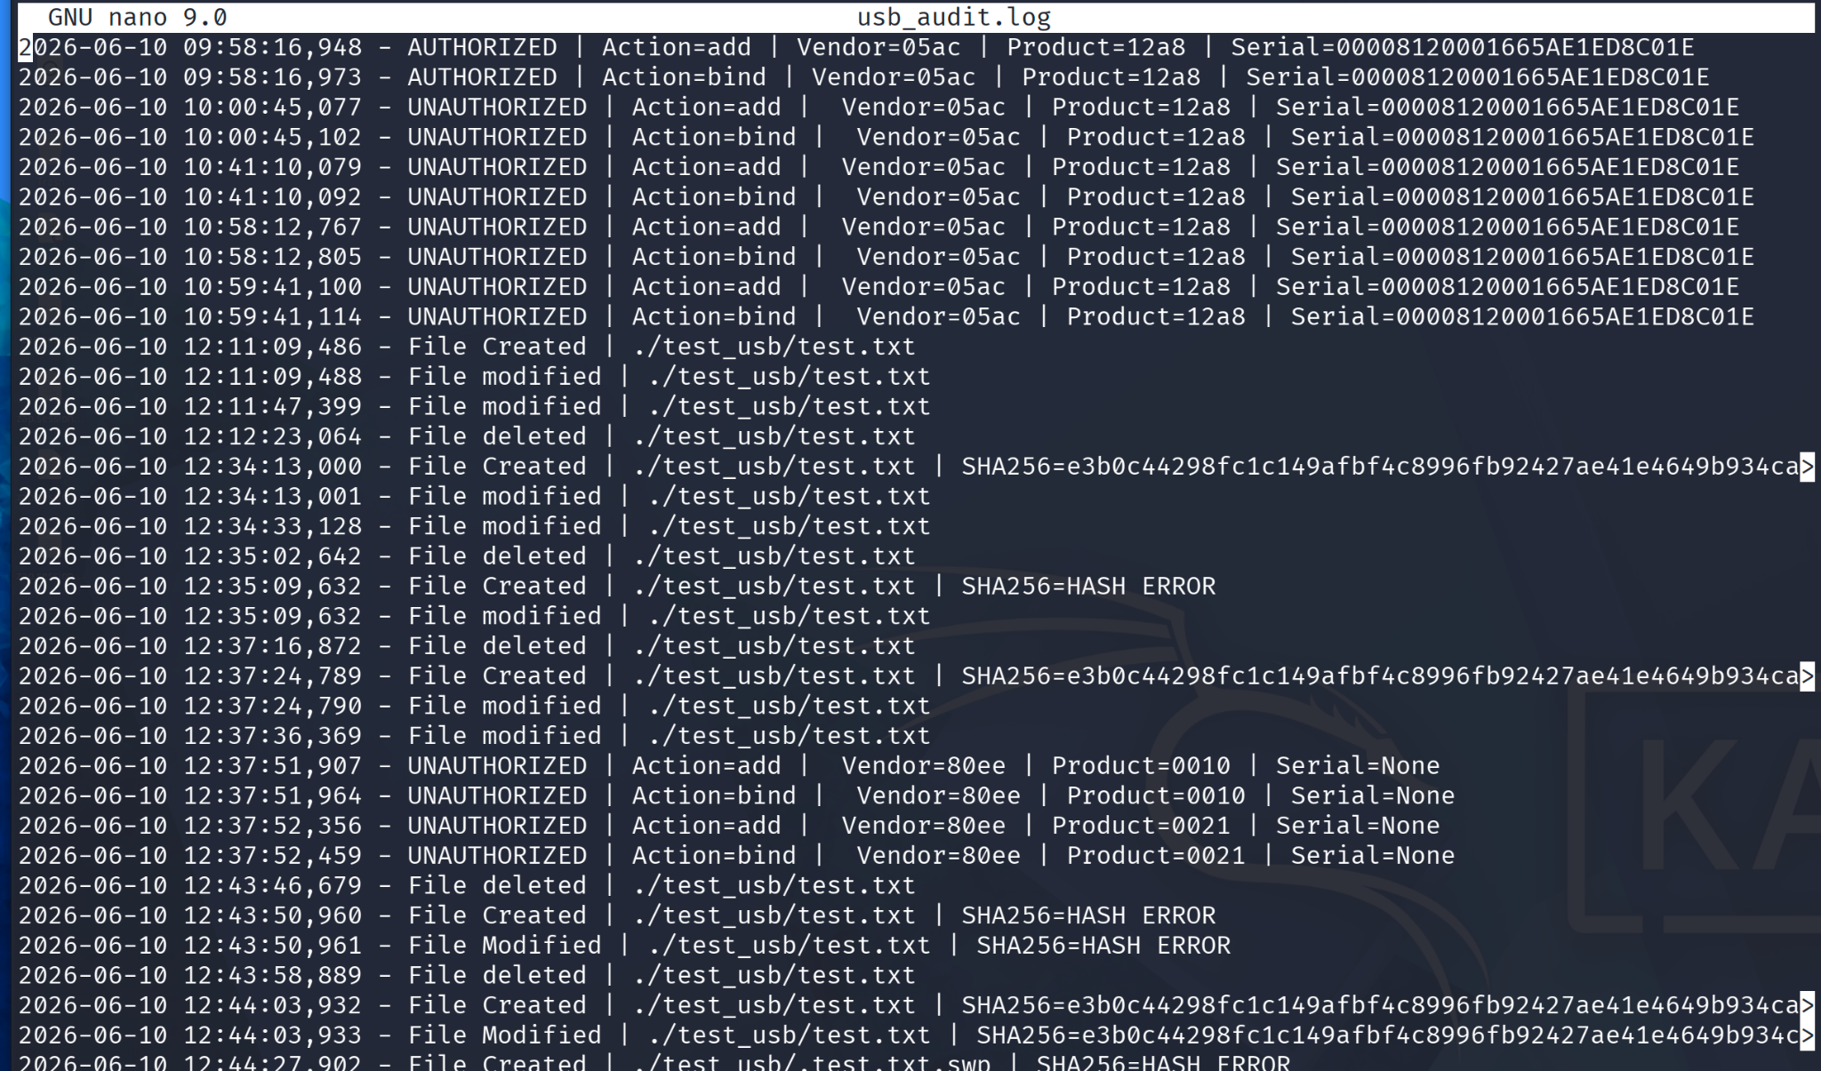
System Configuration and Project Files

Slide 10
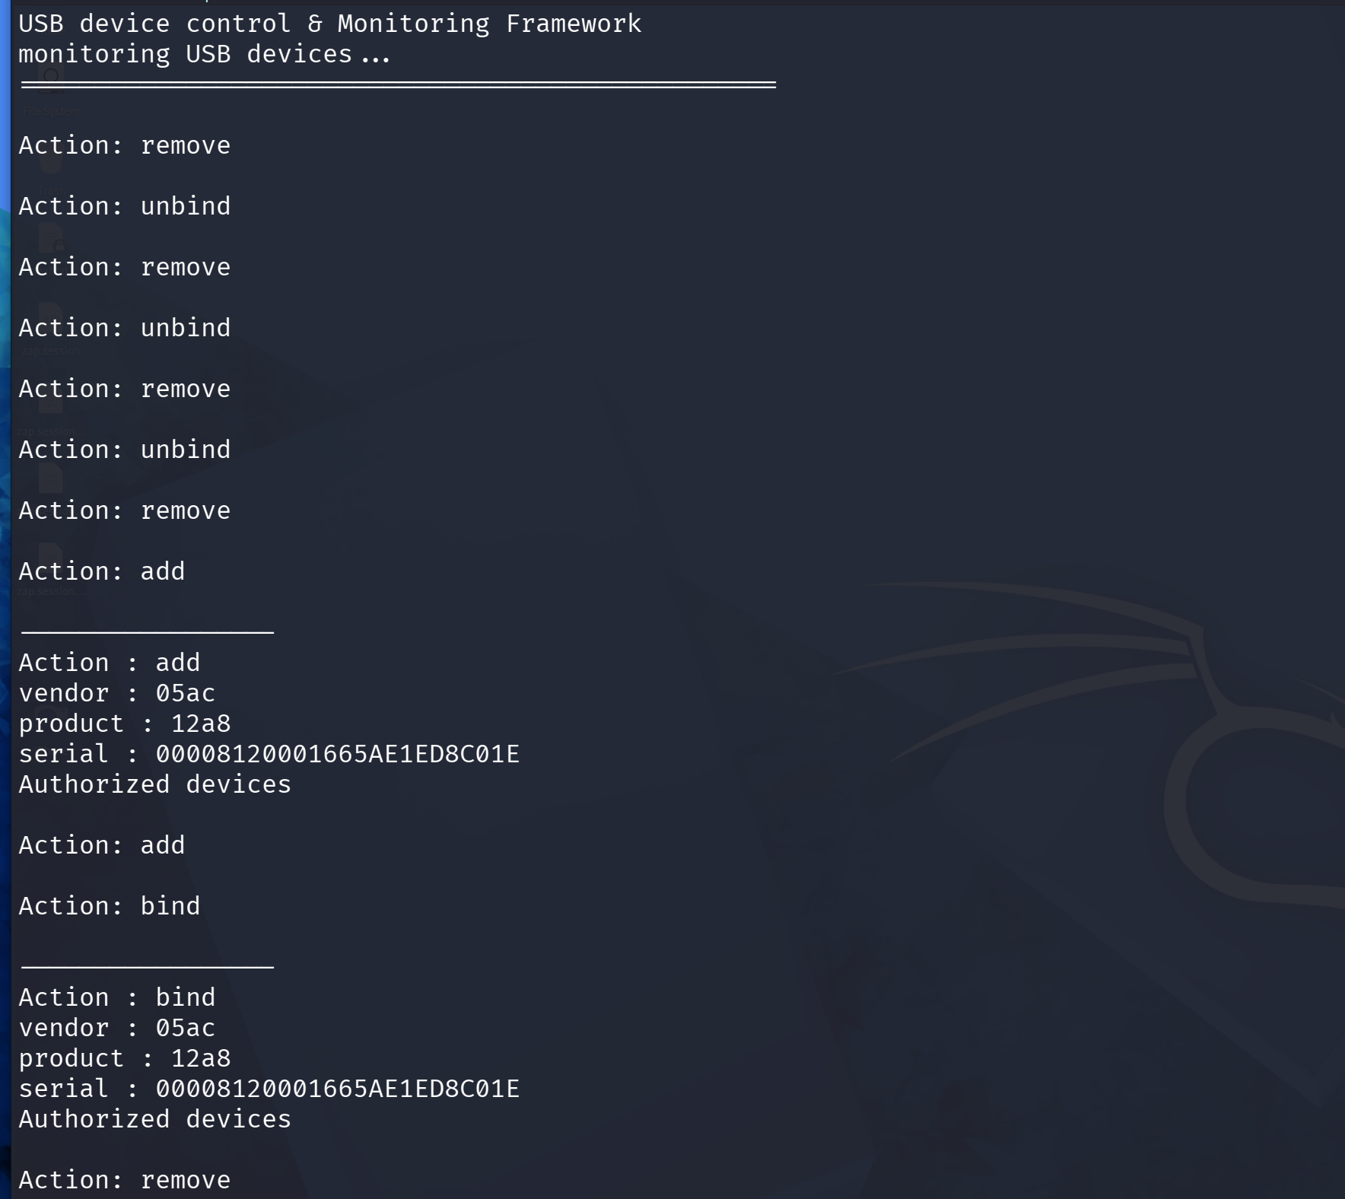
Result

Slide 11
Conclusion
Key Learnings
How pyudev monitors USB hardware events via Linux kernel netlink
Device fingerprinting using Vendor ID / Product ID / Serial Number
Allowlist-based endpoint policy enforcement
File integrity monitoring with SHA256 hashing
Blue team techniques: insider activity tracking

